Slide 1
Client Side Scripting Language
JavaScript

Slide 2
Objective
To learn
  Writing internal and external scripts
  Utilizing built-in objects
  Writing event handling functions
  Validating the form elements using regular expressions
Jackson, Web Technologies: A Computer Science Perspective, © 2007 Prentice-Hall, Inc. All rights reserved. 0-13-185603-0

Slide 3
Outcome
Students will be able to
  Write internal and external scripts
  Utilize built-in objects
  Event handling functions
  Validate the form elements using regular expressions
Jackson, Web Technologies: A Computer Science Perspective, © 2007 Prentice-Hall, Inc. All rights reserved. 0-13-185603-0

Slide 4
Context
HTML and CSS were helpful in designing non-interactive website
However, Javascript is useful to create interactive website
Jackson, Web Technologies: A Computer Science Perspective, © 2007 Prentice-Hall, Inc. All rights reserved. 0-13-185603-0

Slide 5
Javascript – Where to place?
In HTML, JavaScript code must be inserted between <script> and </script> tags
You can place any number of scripts in an HTML document.
Scripts can be placed in the <body>, or in the <head> section of an HTML page, or in both.
In this example, a JavaScript function is placed in the <head> section of an HTML page
The function is invoked (called) when a button is clicked:
Jackson, Web Technologies: A Computer Science Perspective, © 2007 Prentice-Hall, Inc. All rights reserved. 0-13-185603-0

Slide 6
JavaScript Introduction
Let’s write a “Hello World!” JavaScript program
Problem: the JavaScript language itself has no input/output statements(!)
Solution: Most browsers provide de facto standard I/O methods
  alert: pops up alert box containing text
  prompt: pops up window where user can enter text
Jackson, Web Technologies: A Computer Science Perspective, © 2007 Prentice-Hall, Inc. All rights reserved. 0-13-185603-0

Slide 7
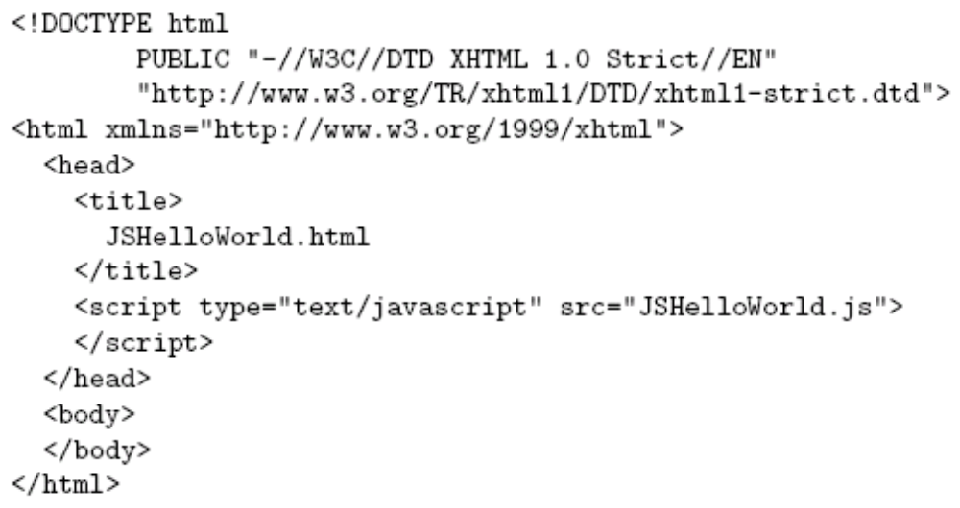
JavaScript Introduction
File JSHelloWorld.js:
HTML document executing this code:
script element used
to load and execute
JavaScript code
Jackson, Web Technologies: A Computer Science Perspective, © 2007 Prentice-Hall, Inc. All rights reserved. 0-13-185603-0

Slide 8
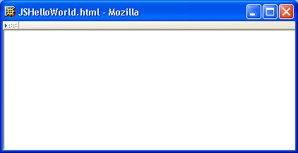
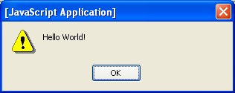
JavaScript Introduction
Web page and alert box generated by JSHelloWorld.html document and JSHelloWorld.js code:
Jackson, Web Technologies: A Computer Science Perspective, © 2007 Prentice-Hall, Inc. All rights reserved. 0-13-185603-0

Slide 9
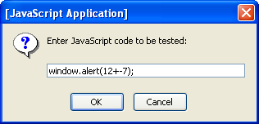
JavaScript Introduction
Prompt window example:
Jackson, Web Technologies: A Computer Science Perspective, © 2007 Prentice-Hall, Inc. All rights reserved. 0-13-185603-0

Slide 10
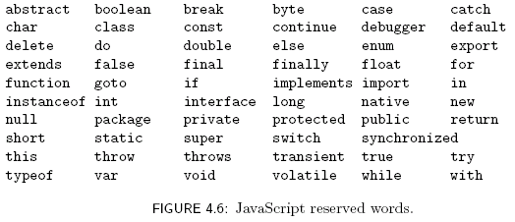
Variables and Data Types
Jackson, Web Technologies: A Computer Science Perspective, © 2007 Prentice-Hall, Inc. All rights reserved. 0-13-185603-0

Slide 11
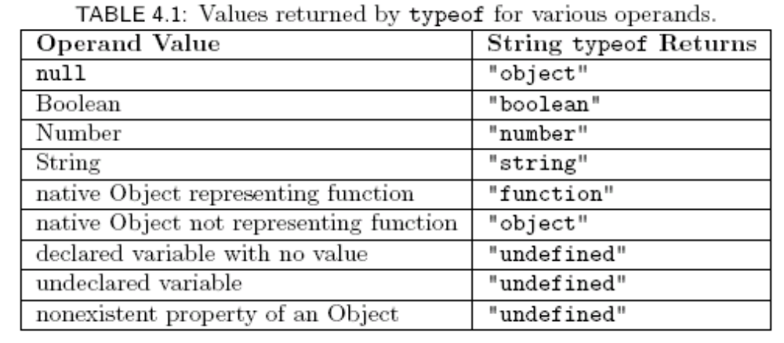
Variables and Data Types
Jackson, Web Technologies: A Computer Science Perspective, © 2007 Prentice-Hall, Inc. All rights reserved. 0-13-185603-0

Slide 12
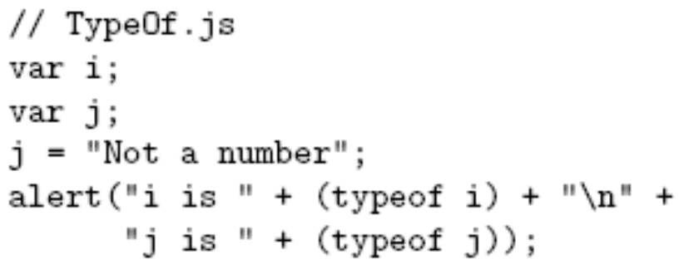
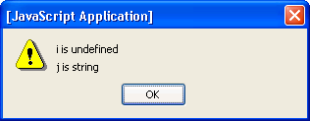
Variables and Data Types
typeof operator returns string related to data type
  Syntax: typeof expression
Example:
Jackson, Web Technologies: A Computer Science Perspective, © 2007 Prentice-Hall, Inc. All rights reserved. 0-13-185603-0

Slide 13
JavaScript Operators
Operators are used to create compound expressions from simpler expressions
Operators can be classified according to the number of operands involved:
  Unary: one operand (e.g., typeof i)
    Prefix or postfix (e.g., ++i or i++ )
  Binary: two operands (e.g., x + y)
  Ternary: three operands (conditional operator)
Jackson, Web Technologies: A Computer Science Perspective, © 2007 Prentice-Hall, Inc. All rights reserved. 0-13-185603-0

Slide 14
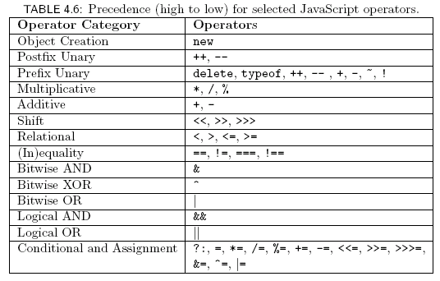
JavaScript Operators
Jackson, Web Technologies: A Computer Science Perspective, © 2007 Prentice-Hall, Inc. All rights reserved. 0-13-185603-0

Slide 15

JavaScript Operators
Associativity:
  Assignment, conditional, and prefix unary operators are right associative: equal-precedence operators are evaluated right-to-left:
  Other operators are left associative: equal-precedence operators are evaluated left-to-right
Jackson, Web Technologies: A Computer Science Perspective, © 2007 Prentice-Hall, Inc. All rights reserved. 0-13-185603-0

Slide 16
JavaScript Operators:
Automatic Type Conversion
Binary operators +, -, *, /, % convert both operands to Number
  Exception: If one of operands of + is String then the other is converted to String
Relational operators <, >, <=, >= convert both operands to Number
  Exception: If both operands are String, no conversion is performed and lexicographic string comparison is performed
Jackson, Web Technologies: A Computer Science Perspective, © 2007 Prentice-Hall, Inc. All rights reserved. 0-13-185603-0

Slide 17
JavaScript Operators:
Automatic Type Conversion
Operators ===, !== are strict:
  Two operands are === only if they are of the same type and have the same value
  “Same value” for objects means that the operands are references to the same object
Unary +, - convert their operand to Number
Logical &&, ||, ! convert their operands to Boolean (normally)
Jackson, Web Technologies: A Computer Science Perspective, © 2007 Prentice-Hall, Inc. All rights reserved. 0-13-185603-0

Slide 18
JavaScript Operators
Bit operators
  Same set as Java:
    Bitwise NOT, AND, OR, XOR (~, &, |, ^)
    Shift operators (<<, >>, >>>)
  Semantics:
    Operands converted to Number, truncated to integer if float, treated as if two’s complement, truncated to low-order 32 bits
    Operators then applied as if in 32-bit registers
    Result of >>> treated as unsigned, others signed
Jackson, Web Technologies: A Computer Science Perspective, © 2007 Prentice-Hall, Inc. All rights reserved. 0-13-185603-0

Slide 19
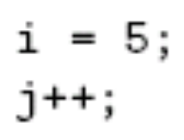
JavaScript Statements
Expression statement: any statement that consists entirely of an expression
  Expression: code that represents a value
Block statement: one or more statements enclosed in { } braces
Keyword statement: statement beginning with a keyword, e.g., var or if
Jackson, Web Technologies: A Computer Science Perspective, © 2007 Prentice-Hall, Inc. All rights reserved. 0-13-185603-0

Slide 20

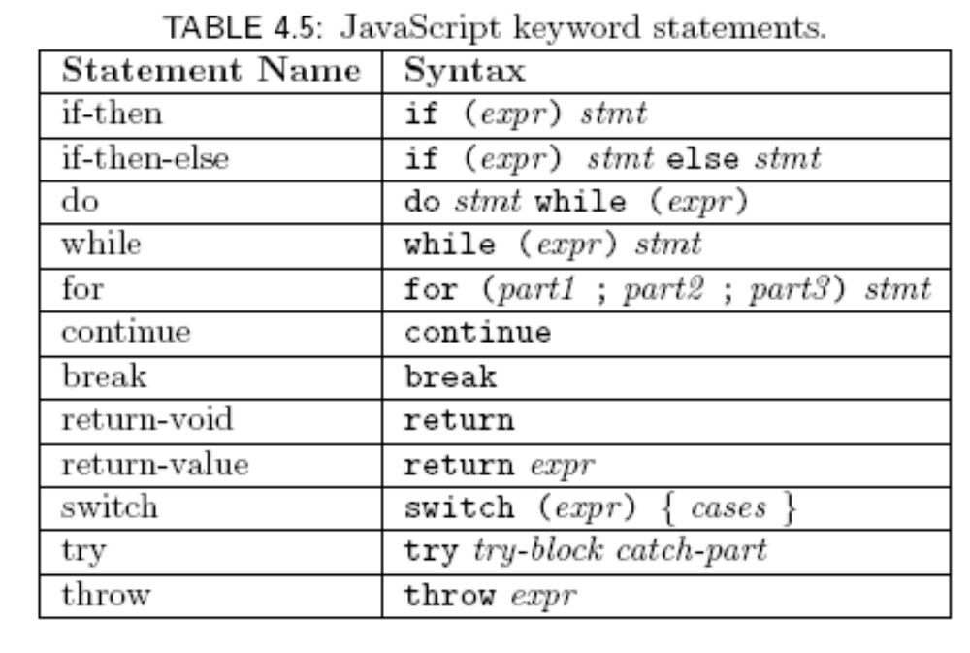
JavaScript Statements
var syntax:
Java-like keyword statements:
Comma-separated declaration list with
optional initializers
Jackson, Web Technologies: A Computer Science Perspective, © 2007 Prentice-Hall, Inc. All rights reserved. 0-13-185603-0

Slide 21
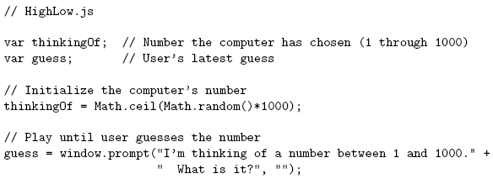
Basic JavaScript Syntax
Jackson, Web Technologies: A Computer Science Perspective, © 2007 Prentice-Hall, Inc. All rights reserved. 0-13-185603-0

Slide 22
Basic JavaScript Syntax
Notice that there is no main() function/method
Jackson, Web Technologies: A Computer Science Perspective, © 2007 Prentice-Hall, Inc. All rights reserved. 0-13-185603-0

Slide 23
Basic JavaScript Syntax
Comments like Java/C++ (/* */ also allowed)
Jackson, Web Technologies: A Computer Science Perspective, © 2007 Prentice-Hall, Inc. All rights reserved. 0-13-185603-0

Slide 24
Basic JavaScript Syntax
Variable declarations:
Not required
Data type not specified
Jackson, Web Technologies: A Computer Science Perspective, © 2007 Prentice-Hall, Inc. All rights reserved. 0-13-185603-0

Slide 25
Basic JavaScript Syntax
Semi-colons are usually
not required, but always
allowed at statement end
Jackson, Web Technologies: A Computer Science Perspective, © 2007 Prentice-Hall, Inc. All rights reserved. 0-13-185603-0

Slide 26
Basic JavaScript Syntax
Arithmetic operators same as Java/C++
Jackson, Web Technologies: A Computer Science Perspective, © 2007 Prentice-Hall, Inc. All rights reserved. 0-13-185603-0

Slide 27
Basic JavaScript Syntax
String concatenation operator
as well as addition
Jackson, Web Technologies: A Computer Science Perspective, © 2007 Prentice-Hall, Inc. All rights reserved. 0-13-185603-0

Slide 28
Basic JavaScript Syntax
Arguments can be any expressions
Argument lists are comma-separated
Jackson, Web Technologies: A Computer Science Perspective, © 2007 Prentice-Hall, Inc. All rights reserved. 0-13-185603-0

Slide 29
Basic JavaScript Syntax
Object dot notation for method calls as in Java/C++
Jackson, Web Technologies: A Computer Science Perspective, © 2007 Prentice-Hall, Inc. All rights reserved. 0-13-185603-0

Slide 30
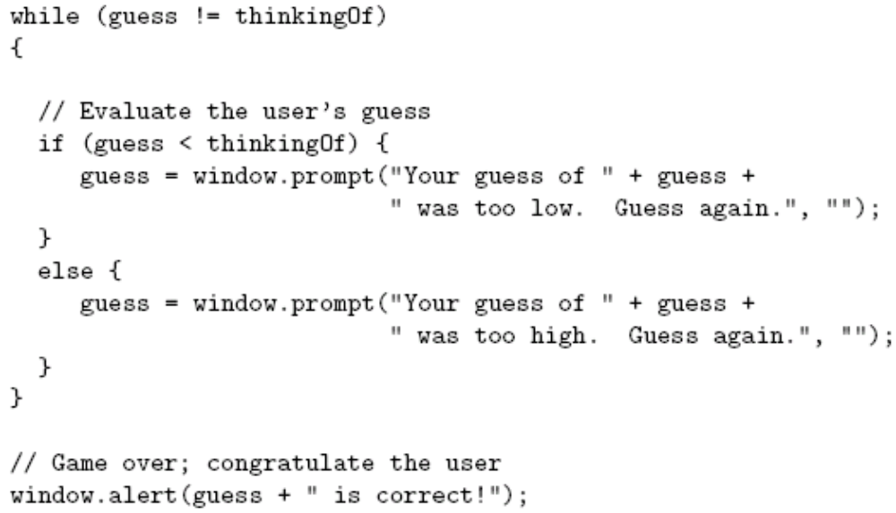
Basic JavaScript Syntax
Jackson, Web Technologies: A Computer Science Perspective, © 2007 Prentice-Hall, Inc. All rights reserved. 0-13-185603-0

Slide 31
Basic JavaScript Syntax
Many control constructs and use of
{ } identical to Java/C++
Jackson, Web Technologies: A Computer Science Perspective, © 2007 Prentice-Hall, Inc. All rights reserved. 0-13-185603-0

Slide 32
Basic JavaScript Syntax
Most relational operators syntactically
same as Java/C++
Jackson, Web Technologies: A Computer Science Perspective, © 2007 Prentice-Hall, Inc. All rights reserved. 0-13-185603-0

Slide 33
Basic JavaScript Syntax
Automatic type conversion:
guess is String,
thinkingOf is Number
Jackson, Web Technologies: A Computer Science Perspective, © 2007 Prentice-Hall, Inc. All rights reserved. 0-13-185603-0

Slide 34
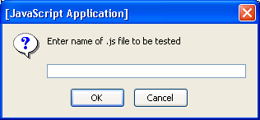
Running Examples
Browse to TestJs.html in examples download package
Enter name of .js file (e.g., HighLow.js) in prompt box:
Jackson, Web Technologies: A Computer Science Perspective, © 2007 Prentice-Hall, Inc. All rights reserved. 0-13-185603-0

Slide 35
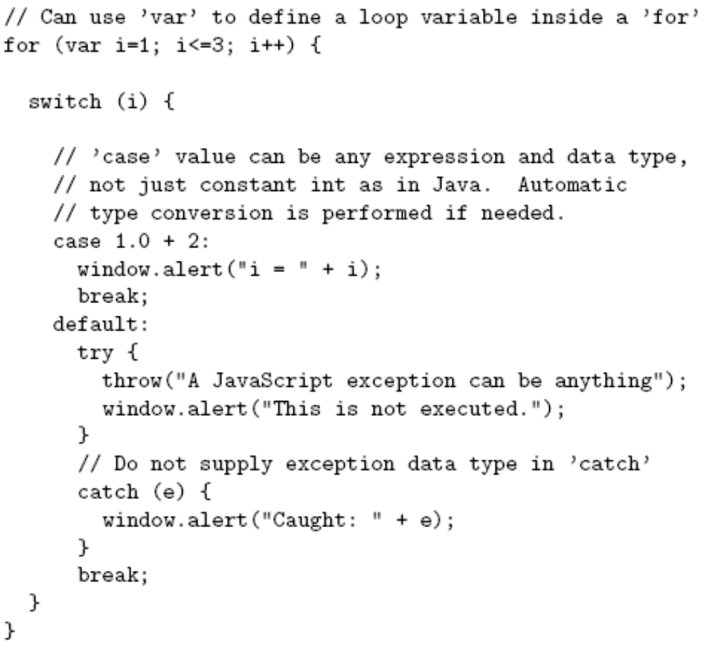
JavaScript Statements
JavaScript
keyword
statements
are very similar
to Java with
small exceptions
Jackson, Web Technologies: A Computer Science Perspective, © 2007 Prentice-Hall, Inc. All rights reserved. 0-13-185603-0

Slide 36
JavaScript Statements
Jackson, Web Technologies: A Computer Science Perspective, © 2007 Prentice-Hall, Inc. All rights reserved. 0-13-185603-0

Slide 37
JavaScript Statements
Jackson, Web Technologies: A Computer Science Perspective, © 2007 Prentice-Hall, Inc. All rights reserved. 0-13-185603-0

Slide 38
JavaScript Statements
Jackson, Web Technologies: A Computer Science Perspective, © 2007 Prentice-Hall, Inc. All rights reserved. 0-13-185603-0

Slide 39
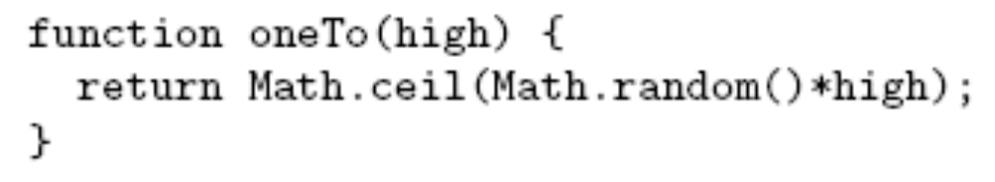
JavaScript Functions
Function declaration syntax
Jackson, Web Technologies: A Computer Science Perspective, © 2007 Prentice-Hall, Inc. All rights reserved. 0-13-185603-0

Slide 40
JavaScript Functions
Function declaration syntax
Declaration
always begins
with keyword
function,
no return type
Jackson, Web Technologies: A Computer Science Perspective, © 2007 Prentice-Hall, Inc. All rights reserved. 0-13-185603-0

Slide 41
JavaScript Functions
Function declaration syntax
Identifier representing
function’s name
Jackson, Web Technologies: A Computer Science Perspective, © 2007 Prentice-Hall, Inc. All rights reserved. 0-13-185603-0

Slide 42
JavaScript Functions
Function declaration syntax
Formal parameter list
Jackson, Web Technologies: A Computer Science Perspective, © 2007 Prentice-Hall, Inc. All rights reserved. 0-13-185603-0

Slide 43
JavaScript Functions
Function declaration syntax
One or more statements representing
function body
Jackson, Web Technologies: A Computer Science Perspective, © 2007 Prentice-Hall, Inc. All rights reserved. 0-13-185603-0

Slide 44

JavaScript Functions
Function call syntax
Jackson, Web Technologies: A Computer Science Perspective, © 2007 Prentice-Hall, Inc. All rights reserved. 0-13-185603-0

Slide 45
JavaScript Functions
Function call syntax
Function name
Jackson, Web Technologies: A Computer Science Perspective, © 2007 Prentice-Hall, Inc. All rights reserved. 0-13-185603-0

Slide 46
JavaScript Functions
Function call syntax
Argument list
Jackson, Web Technologies: A Computer Science Perspective, © 2007 Prentice-Hall, Inc. All rights reserved. 0-13-185603-0

Slide 47
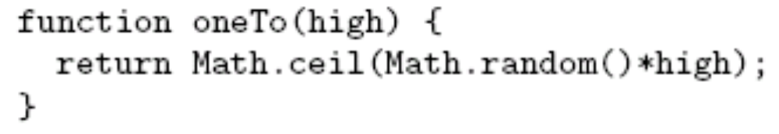
JavaScript Functions
Function call semantics:
Jackson, Web Technologies: A Computer Science Perspective, © 2007 Prentice-Hall, Inc. All rights reserved. 0-13-185603-0

Slide 48
JavaScript Functions
Function call semantics:
Argument value(s)
associated with corresponding
formal parameters
Jackson, Web Technologies: A Computer Science Perspective, © 2007 Prentice-Hall, Inc. All rights reserved. 0-13-185603-0

Slide 49
JavaScript Functions
Number mismatch between argument list and formal parameter list:
  More arguments: excess ignored
  Fewer arguments: remaining parameters are Undefined
Jackson, Web Technologies: A Computer Science Perspective, © 2007 Prentice-Hall, Inc. All rights reserved. 0-13-185603-0

Slide 50

JavaScript Arrays
The Array built-in object can be used to construct objects with special properties and that inherit various methods
ary1
length (0)
Properties
Inherited
methods
toString()
sort()
shift()
…
Jackson, Web Technologies: A Computer Science Perspective, © 2007 Prentice-Hall, Inc. All rights reserved. 0-13-185603-0

Slide 51
JavaScript Arrays
The Array built-in object can be used to construct objects with special properties and that inherit various methods
ary2
length (3)
“0” (4)
“1” (true)
“2” (“OK”)
Accessing array elements:
ary2[1]
ary2[“1”]
ary2.1
Elements
of array
Must follow identifier
syntax rules
toString()
…
Jackson, Web Technologies: A Computer Science Perspective, © 2007 Prentice-Hall, Inc. All rights reserved. 0-13-185603-0

Slide 52

JavaScript Arrays
The Array constructor is indirectly called if an array initializer is used
Array initializiers can be used to create multidimensional arrays
ttt[1][2]
Jackson, Web Technologies: A Computer Science Perspective, © 2007 Prentice-Hall, Inc. All rights reserved. 0-13-185603-0

Slide 53

JavaScript Arrays
Changing the number of elements:
Creates a new element dynamically,
increases value of length
ary2
length (4)
“0” (4)
“1” (true)
“2” (“OK”)
“3” (-12.6)
toString()
…
Jackson, Web Technologies: A Computer Science Perspective, © 2007 Prentice-Hall, Inc. All rights reserved. 0-13-185603-0

Slide 54

JavaScript Arrays
Changing the number of elements:
Decreasing length can delete elements
ary2
length (2)
“0” (4)
“1” (true)
toString()
…
Jackson, Web Technologies: A Computer Science Perspective, © 2007 Prentice-Hall, Inc. All rights reserved. 0-13-185603-0

Slide 55
JavaScript Arrays
Value of length is not necessarily the same as the actual number of elements
var ary4 = new Array(200);
Calling constructor with single argument
sets length, does not create elements
ary4
length (200)
toString()
sort()
shift()
…
Jackson, Web Technologies: A Computer Science Perspective, © 2007 Prentice-Hall, Inc. All rights reserved. 0-13-185603-0

Slide 56
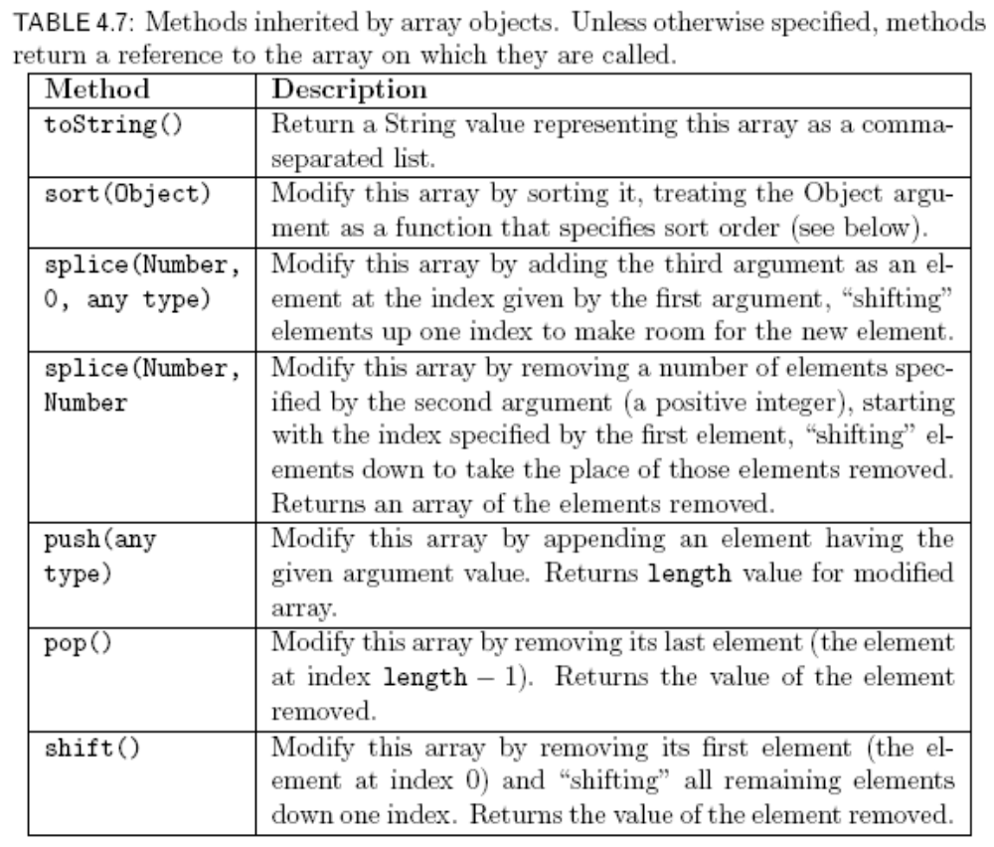
JavaScript Arrays
Jackson, Web Technologies: A Computer Science Perspective, © 2007 Prentice-Hall, Inc. All rights reserved. 0-13-185603-0

Slide 57
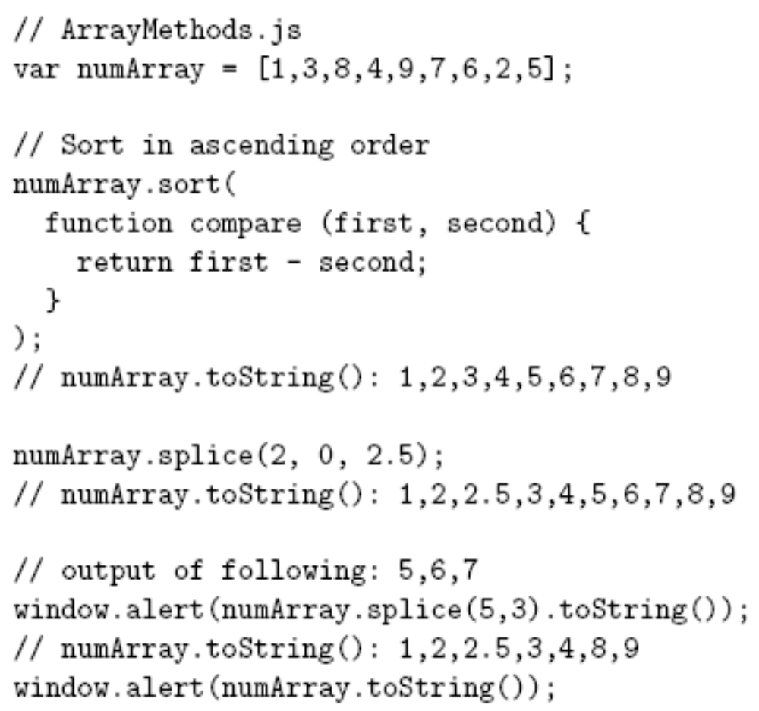
JavaScript Arrays
Jackson, Web Technologies: A Computer Science Perspective, © 2007 Prentice-Hall, Inc. All rights reserved. 0-13-185603-0

Slide 58
JavaScript Arrays
Argument to sort
is a function
Jackson, Web Technologies: A Computer Science Perspective, © 2007 Prentice-Hall, Inc. All rights reserved. 0-13-185603-0

Slide 59
JavaScript Arrays
Return negative if first value should
come before second after sorting
Jackson, Web Technologies: A Computer Science Perspective, © 2007 Prentice-Hall, Inc. All rights reserved. 0-13-185603-0

Slide 60
JavaScript Arrays
Add element with value 2.5 at
index 2, shift existing elements
Jackson, Web Technologies: A Computer Science Perspective, © 2007 Prentice-Hall, Inc. All rights reserved. 0-13-185603-0

Slide 61
JavaScript Arrays
Remove 3 elements starting
at index 5
Jackson, Web Technologies: A Computer Science Perspective, © 2007 Prentice-Hall, Inc. All rights reserved. 0-13-185603-0

Slide 62
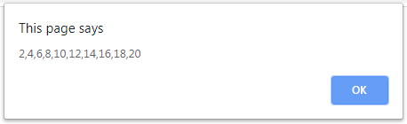
toString() method
<html>
<body>
<h1>Demonstration of Arrays</h1>
<script type="text/javascript">
var a=[2,4,6,8,10,12,14,16,18,20];
window.alert(a.toString());
</body>
</html>
Jackson, Web Technologies: A Computer Science Perspective, © 2007 Prentice-Hall, Inc. All rights reserved. 0-13-185603-0

Slide 63
push(), pop(), shift() methods
push() method adds a new element to an array (at the end):
var fruits = ["Banana", "Orange", "Apple", "Mango"];
fruits.push("Kiwi"); // Adds a new element ("Kiwi") to fruits
pop() method returns the value that was "popped out":
var fruits = ["Banana", "Orange", "Apple", "Mango"];
var x = fruits.pop(); // the value of x is "Mango“
shift() method removes the first array element and "shifts" all other elements to a lower index
var fruits = ["Banana", "Orange", "Apple", "Mango"];
var x = fruits.shift(); // the value of x is "Banana"
Jackson, Web Technologies: A Computer Science Perspective, © 2007 Prentice-Hall, Inc. All rights reserved. 0-13-185603-0

Slide 64
Splice method in an array
var fruits = ["Banana", "Orange", "Apple", "Mango"];
fruits.splice(2, 0, "Lemon", "Kiwi");
The first parameter (2) defines the position where new elements should be added (spliced in).
The second parameter (0) defines how many elements should be removed.
The rest of the parameters ("Lemon" , "Kiwi") define the new elements to be added.
The splice() method returns an array with the deleted items:
Jackson, Web Technologies: A Computer Science Perspective, © 2007 Prentice-Hall, Inc. All rights reserved. 0-13-185603-0

Slide 65
Splice method in an array
Original Array:
Banana,Orange,Apple,Mango
New Array:
Banana,Orange,Lemon,Kiwi,Apple,Mango
fruits.splice(2, 0, "Lemon", "Kiwi");
Original Array:
Banana,Orange,Apple,Mango
New Array:
Banana,Orange,Lemon,Kiwi
Jackson, Web Technologies: A Computer Science Perspective, © 2007 Prentice-Hall, Inc. All rights reserved. 0-13-185603-0

Slide 66
Sorting of elements in an Array
var fruits = ["Banana", "Orange", "Apple", "Mango"];
fruits.sort()
Original Array:
Banana,Orange,Apple,Mango
New Array:
Apple, Banana,Mango,Orange
fruits.sort()
fruits.reverse()
New Array:
Orange,Mango,Banana,Apple
Jackson, Web Technologies: A Computer Science Perspective, © 2007 Prentice-Hall, Inc. All rights reserved. 0-13-185603-0

Slide 67
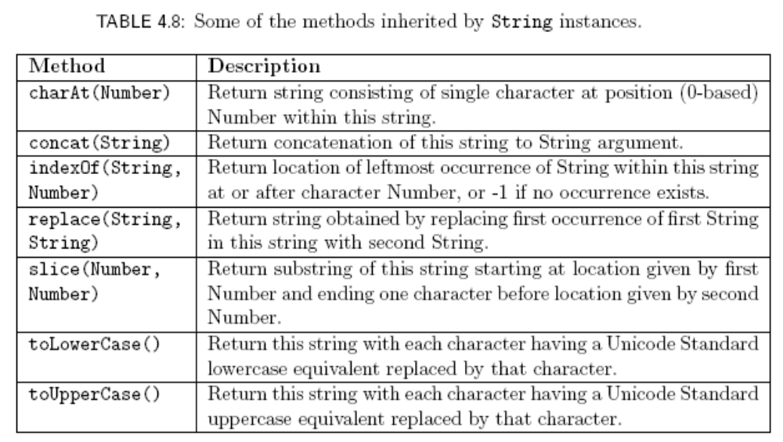
Built-in Objects - String
Jackson, Web Technologies: A Computer Science Perspective, © 2007 Prentice-Hall, Inc. All rights reserved. 0-13-185603-0

Slide 68
Built-in Objects - Date
The Date() built-in constructor can be used to create Date instances that represent the current date and time
Often used to display local date and/or time in Web pages
Other methods: toLocaleDateString() , toLocaleTimeString(), etc.
var now = new Date();
window.alert(“Current date and time: “
+ now.toLocaleString());
Jackson, Web Technologies: A Computer Science Perspective, © 2007 Prentice-Hall, Inc. All rights reserved. 0-13-185603-0

Slide 69
Methods of Date object
getDate()
getMonth()
getYear()
getFullYear()
getDay()
getTime()
getHours()
getMinutes()
getSeconds()
getMilliseconds()
Jackson, Web Technologies: A Computer Science Perspective, © 2007 Prentice-Hall, Inc. All rights reserved. 0-13-185603-0

Slide 70

Built-in Objects - Math
Math object has methods for performing standard mathematical calculations:
Also has properties with approximate values for standard mathematical quantities, e.g., e ( Math.E ) and π (Math.PI)
Jackson, Web Technologies: A Computer Science Perspective, © 2007 Prentice-Hall, Inc. All rights reserved. 0-13-185603-0

Slide 71
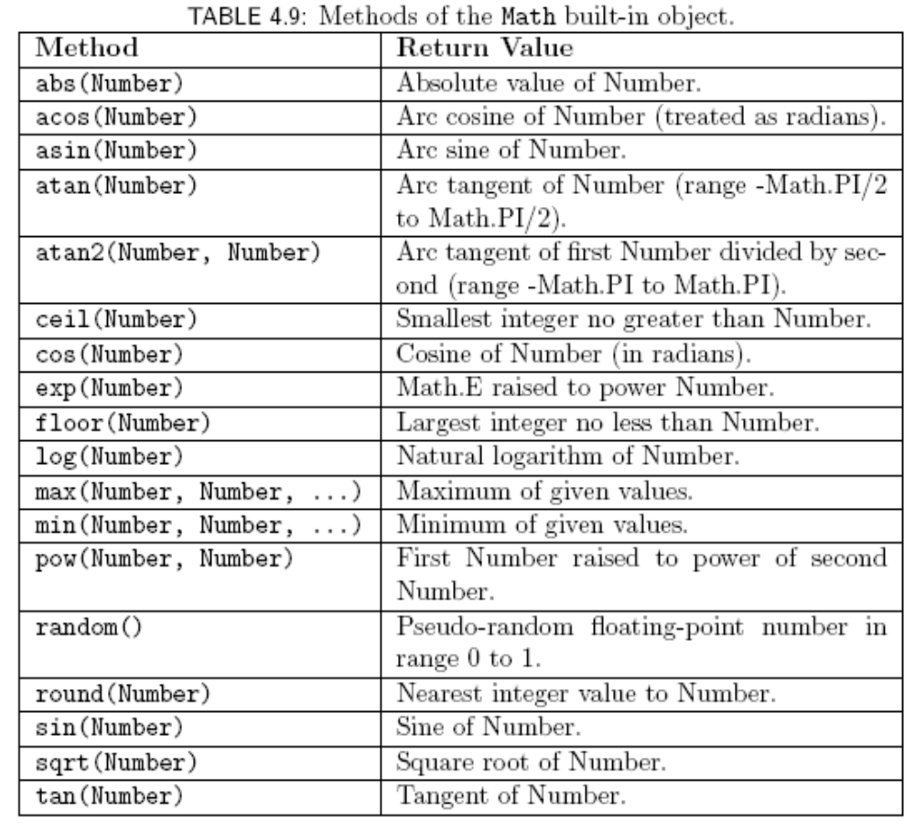
Built-in Objects
Jackson, Web Technologies: A Computer Science Perspective, © 2007 Prentice-Hall, Inc. All rights reserved. 0-13-185603-0

Slide 72

JavaScript Regular Expressions
A regular expression is a particular representation of a set of strings
  Ex: JavaScript regular expression representing the set of syntactically-valid US telephone area codes (three-digit numbers):
    \d represents the set {“0”, “1”, …, “9”}
    Concatenated regular expressions represent the “concatenation” (Cartesian product) of their sets
Jackson, Web Technologies: A Computer Science Perspective, © 2007 Prentice-Hall, Inc. All rights reserved. 0-13-185603-0

Slide 73
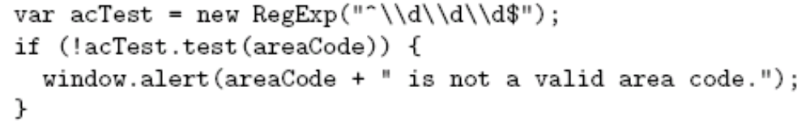
JavaScript Regular Expressions
Using regular expressions in JavaScript
Jackson, Web Technologies: A Computer Science Perspective, © 2007 Prentice-Hall, Inc. All rights reserved. 0-13-185603-0

Slide 74
JavaScript Regular Expressions
Using regular expressions in JavaScript
Variable containing string to be tested
Jackson, Web Technologies: A Computer Science Perspective, © 2007 Prentice-Hall, Inc. All rights reserved. 0-13-185603-0

Slide 75
JavaScript Regular Expressions
Using regular expressions in JavaScript
Regular expression as String (must escape \)
Jackson, Web Technologies: A Computer Science Perspective, © 2007 Prentice-Hall, Inc. All rights reserved. 0-13-185603-0

Slide 76
JavaScript Regular Expressions
Using regular expressions in JavaScript
Built-in constructor
Jackson, Web Technologies: A Computer Science Perspective, © 2007 Prentice-Hall, Inc. All rights reserved. 0-13-185603-0

Slide 77
JavaScript Regular Expressions
Using regular expressions in JavaScript
Method inherited by RegExp instances:
returns true if the argument contains a
substring in the set of strings represented by
the regular expression
Jackson, Web Technologies: A Computer Science Perspective, © 2007 Prentice-Hall, Inc. All rights reserved. 0-13-185603-0

Slide 78
JavaScript Regular Expressions
Using regular expressions in JavaScript
Represents beginning of string
Represents end of string
This expression matches only strings with
exactly three digits (no other characters,
even white space)
Jackson, Web Technologies: A Computer Science Perspective, © 2007 Prentice-Hall, Inc. All rights reserved. 0-13-185603-0

Slide 79
JavaScript Regular Expressions
Using regular expressions in JavaScript
Alternate syntax:
Represents all strings that begin
with three digits
Regular expression literal.
Do not escape \.
Jackson, Web Technologies: A Computer Science Perspective, © 2007 Prentice-Hall, Inc. All rights reserved. 0-13-185603-0

Slide 80
JavaScript Regular Expressions
Simplest regular expression is any character that is not a special character:
  Ex: _ is a regular expression representing {“_”}
Backslash-escape d special character is also a regular expression
  Ex: \$ represents {“$”}
Jackson, Web Technologies: A Computer Science Perspective, © 2007 Prentice-Hall, Inc. All rights reserved. 0-13-185603-0

Slide 81
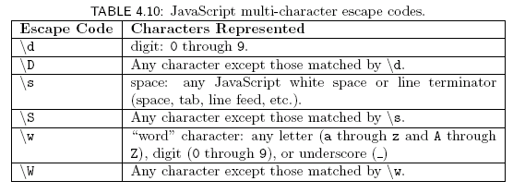
JavaScript Regular Expressions
Special character . (dot) represents any character except a line terminator
Several escape codes are regular expressions representing sets of chars:
Jackson, Web Technologies: A Computer Science Perspective, © 2007 Prentice-Hall, Inc. All rights reserved. 0-13-185603-0

Slide 82
JavaScript Regular Expressions
Three types of operations can be used to combine simple regular expressions into more complex expressions:
  Concatenation
  Union (|)
  Kleene star (*)
XML DTD content specification syntax based in part on regular expressions
Jackson, Web Technologies: A Computer Science Perspective, © 2007 Prentice-Hall, Inc. All rights reserved. 0-13-185603-0

Slide 83


JavaScript Regular Expressions
Concatenation
  Example:
    String consisting entirely of four characters:
    Digit followed by
    A . followed by
    A single space followed by
    Any “word” character
  Quantifier shorthand syntax for concatenation:
Jackson, Web Technologies: A Computer Science Perspective, © 2007 Prentice-Hall, Inc. All rights reserved. 0-13-185603-0

Slide 84



JavaScript Regular Expressions
Union
  Ex:
  Union of set of strings represented by regular expressions
    Set of single-character strings that are either a digit or a space character
Character class: shorthand for union of one or more ranges of characters
  Ex: set of lower case letters
  Ex: the \w escape code class
Jackson, Web Technologies: A Computer Science Perspective, © 2007 Prentice-Hall, Inc. All rights reserved. 0-13-185603-0

Slide 85



JavaScript Regular Expressions
Unions of concatenations
  Note that concatenation has higher precedence than union
Optional regular expression
Jackson, Web Technologies: A Computer Science Perspective, © 2007 Prentice-Hall, Inc. All rights reserved. 0-13-185603-0

Slide 86

JavaScript Regular Expressions
Kleene star
  Ex: any number of digits (including none)
  Ex:
    Strings consisting of only “word” characters
    String must contain both a digit and a letter (in either order)
Jackson, Web Technologies: A Computer Science Perspective, © 2007 Prentice-Hall, Inc. All rights reserved. 0-13-185603-0

Slide 87
Javascript Events
An HTML event can be something the browser does, or something a user does
  Onclick()
  Onmouseover
  Onmouseout
  Onload()
  Onchange()
  Onblur()
Jackson, Web Technologies: A Computer Science Perspective, © 2007 Prentice-Hall, Inc. All rights reserved. 0-13-185603-0

Slide 88
Simple Questions
How to change the content of HTML element?
How to change the style of HTML element?
How to validate checkbox content?
When to write script in head part of HTML?
How to write regular expression for getting numerical input?
How js arrays are different?
What is dynamically typed variables?
Jackson, Web Technologies: A Computer Science Perspective, © 2007 Prentice-Hall, Inc. All rights reserved. 0-13-185603-0

Slide 89
References
www.w3schools.com
Deitel and Deitel and Nieto, ―Internet and World Wide Web - How to Program‖, Prentice Hall, 5th Edition, 2011.
Jeffrey C and Jackson, ―Web Technologies A Computer Science Perspective‖, Pearson Education, 2011.
Jackson, Web Technologies: A Computer Science Perspective, © 2007 Prentice-Hall, Inc. All rights reserved. 0-13-185603-0

Slide 90
Summary
Students will be able to
  Write internal and external scripts
  Utilize built-in objects
  Event handling functions
  Validate the form elements using regular expressions
Jackson, Web Technologies: A Computer Science Perspective, © 2007 Prentice-Hall, Inc. All rights reserved. 0-13-185603-0

